Slide 1
Trusted AI Challenge - Stage 2
Presented By
Mohammed Hamza Chao
Nishat Ara Nipa
Dr. Sachin Shetty
Old Dominion University

Slide 2

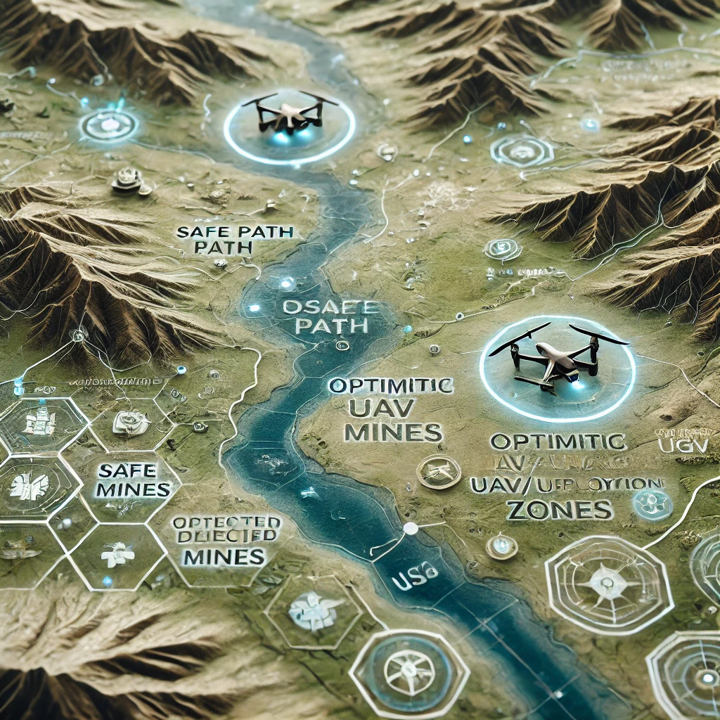
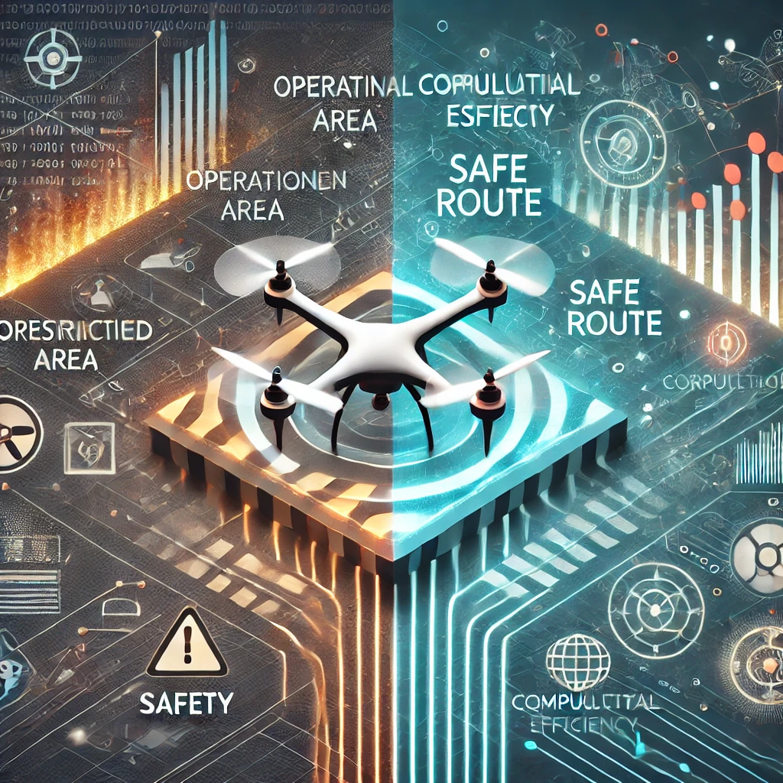
Overview of Stage-2
Key Objectives:
Enhance the reliability of decision-making
Leverage terrain-specific insights for better mission performance
Balance operational safety with computational efficiency.

Slide 3
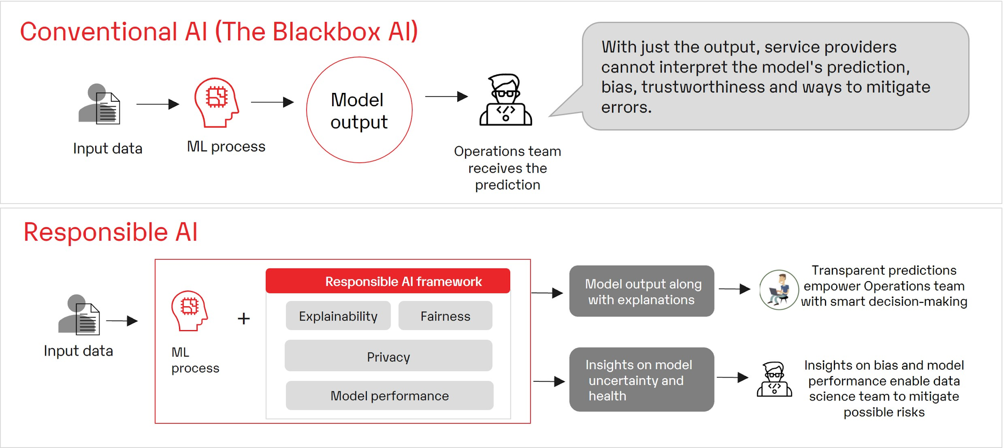
Why Trust Matters in AI-Enabled Systems
Ref: https://www.prodapt.com/realizing-the-trustworthiness-of-ai-systems/

Slide 4

Simulation Environment Overview
Expected Outcomes:
Simulate a seamless UAV-UGV coordination system across a hexagonal mission map.
Enhances operational readiness by optimizing safety, cost, and confidence in decisions.
Integrate AI-driven insights with human estimation for terrain-specific challenges.
Balance: Safety, Cost Efficiency, Confidence

Slide 5
We Introduce the “Decision Class Framework”
Core Capabilities
UAV Scanning: Prepares terrain data for operations.
Mine Detection: Balances AI efficiency with human judgment.
Path Optimization: Uses Dijkstra’s algorithm for safe, efficient traversal.
UGV Execution: Ensures safe navigation and mine clearance.

Slide 6
UAV Operations - Scanning the Terrain:
Purpose
Simulate UAV traversal across the entire hexagonal map.
Conduct aerial scanning for mine detection and terrain preparation.
Process
Hexagon-by-Hexagon Movement: UAV visits every hexagon on the mission map.
Cost Update: Each hexagon increments the Mission cost by a fixed traversal time.
Collection: Imagery data collected to detect potential threats and inform UGV operations.
Use Case
- Establishes a reliable baseline for terrain analysis
- Sets up essential data for mine detection and path optimization.
- Ensures the terrain is thoroughly scanned and ready for UGV traversal
First critical step in the mission simulation process.
Outcome

Slide 7
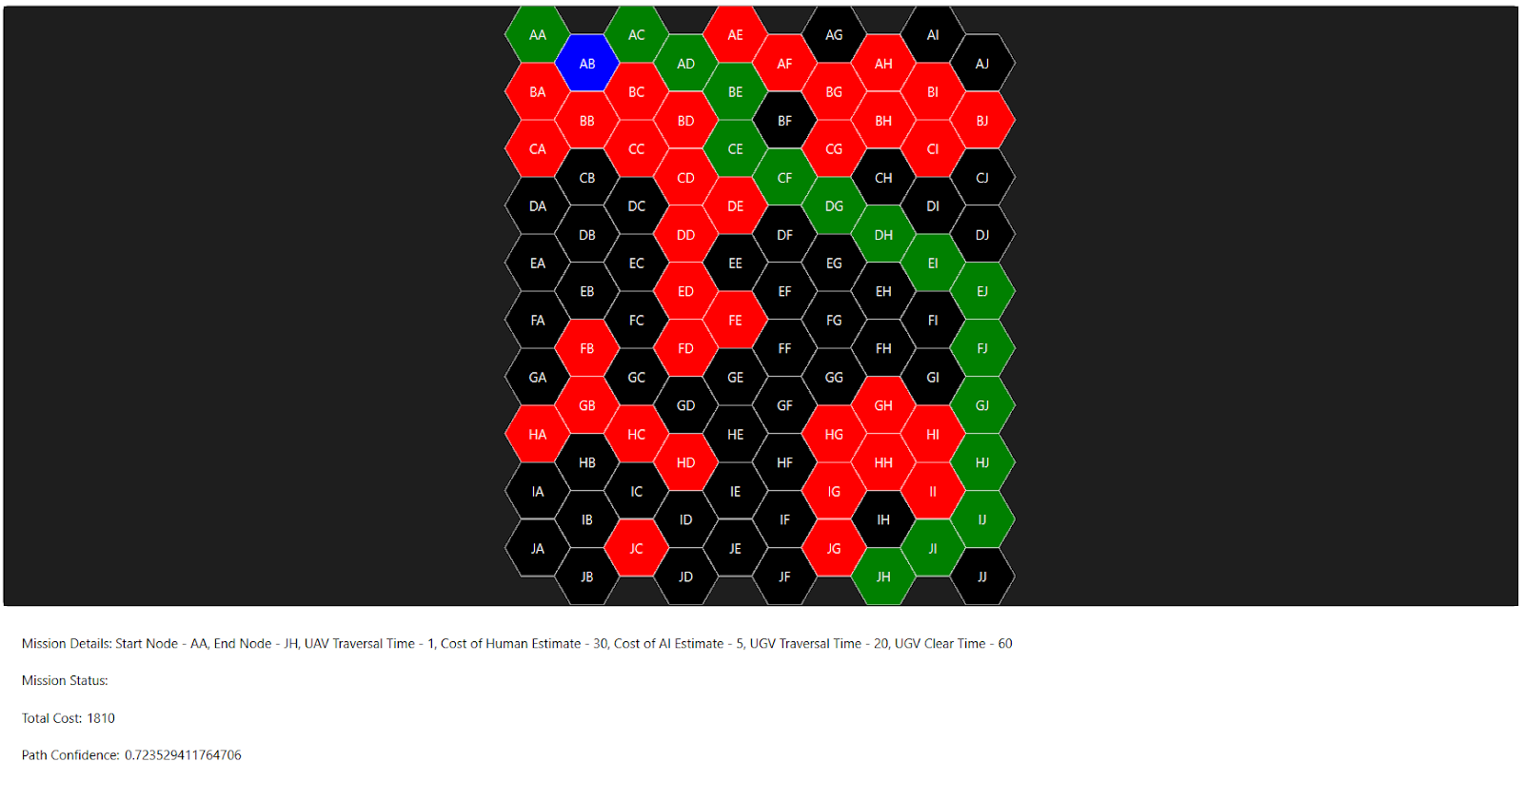
Adaptive Mine Detection
Purpose:
Detect landmines by combining AI-based scanning and human estimation for optimal performance.
Leverage terrain-specific strategies to balance efficiency and accuracy.
Mechanism:
The method iterates through all hexagons on the map and selects the optimal detection strategy:
General Terrain: AI scanning is applied across all hexagons to provide an initial estimation, and the mission's total cost is incremented with the AI cost for each scan.
Rocky/Wooded Terrain: These terrains present unique challenges where human estimation shows slightly better performance compared to AI. For such terrains, the confidence score of the AI is evaluated.
If the AI's confidence score is below 70%, human estimation is employed, and the mission's total cost is incremented with the corresponding human estimation cost.
If the AI's confidence score is 70% or higher, AI estimation is retained for efficiency.

Slide 8
Adaptive Mine Detection (cont.)
Performance Context:
In the domain of object detection, achieving a confidence threshold of 70% is deemed competitive for practical applications.
For example, models like YOLOv3 have reported mean Average Precision (mAP) scores in the range of 55–70% on the MS COCO dataset, emphasizing their utility in real-time and resource-constrained tasks (Redmon & Farhadi, 2018).
Visualization:
Hexagons identified to contain landmines are marked in red on the map, ensuring clarity in visualization and aiding subsequent decision-making processes.
Use Case:
Balances:
- AI efficiency for general terrains.
- Human estimation accuracy for challenging terrains (e.g., rocky, wooded).
Supports pathfinding by:
- Marking mine locations.
- Updating mission costs.
- Integrating terrain-specific confidence scores.

Slide 9
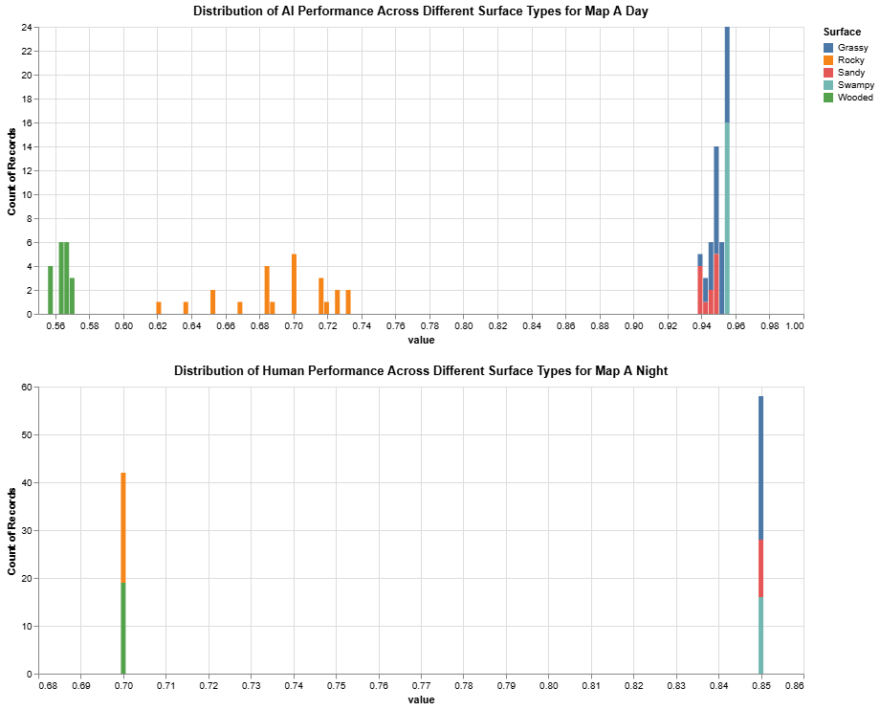
Human-AI Teaming

Slide 10
Optimized Path Finding
Dijkstra’s Algorithm: A widely used method for finding the shortest path from a starting node to a target node in a weighted graph.
Purpose: Implements Dijkstra’s algorithm to find the optimal path between a start hexagon and a goal hexagon.
Mechanism:
- Assigns weights to terrains based on detection performance, derived from summer findings:
Grassy (1) – Best detection performance.
Sandy (2).
Wooded (10).
Swampy (15).
Rocky (25) – Worst detection performance.
- Prioritizes paths with the following objectives:
Maximizes confidence score.
Minimizes mine encounters.
Balances traversal costs effectively.
- Reconstructs the optimal path, marking it green and highlighting detected mines in blue.
Use Case: Utilized to determine the safest and most efficient path for the UGV, avoiding mines and minimizing traversal costs while achieving high confidence.

Slide 11
UGV Execution:
Purpose: Simulates UGV traversal along a specified path.
Mechanism:
The UGV traverses the hexagons in the given path.
For each hexagon:
Increments mission cost by UGV traversal time.
Increments landmine clearance time if a mine is present.
Use Case: Completes the mission by safely navigating the UGV through the optimal path determined by Dijkstra’s algorithm.

Slide 12
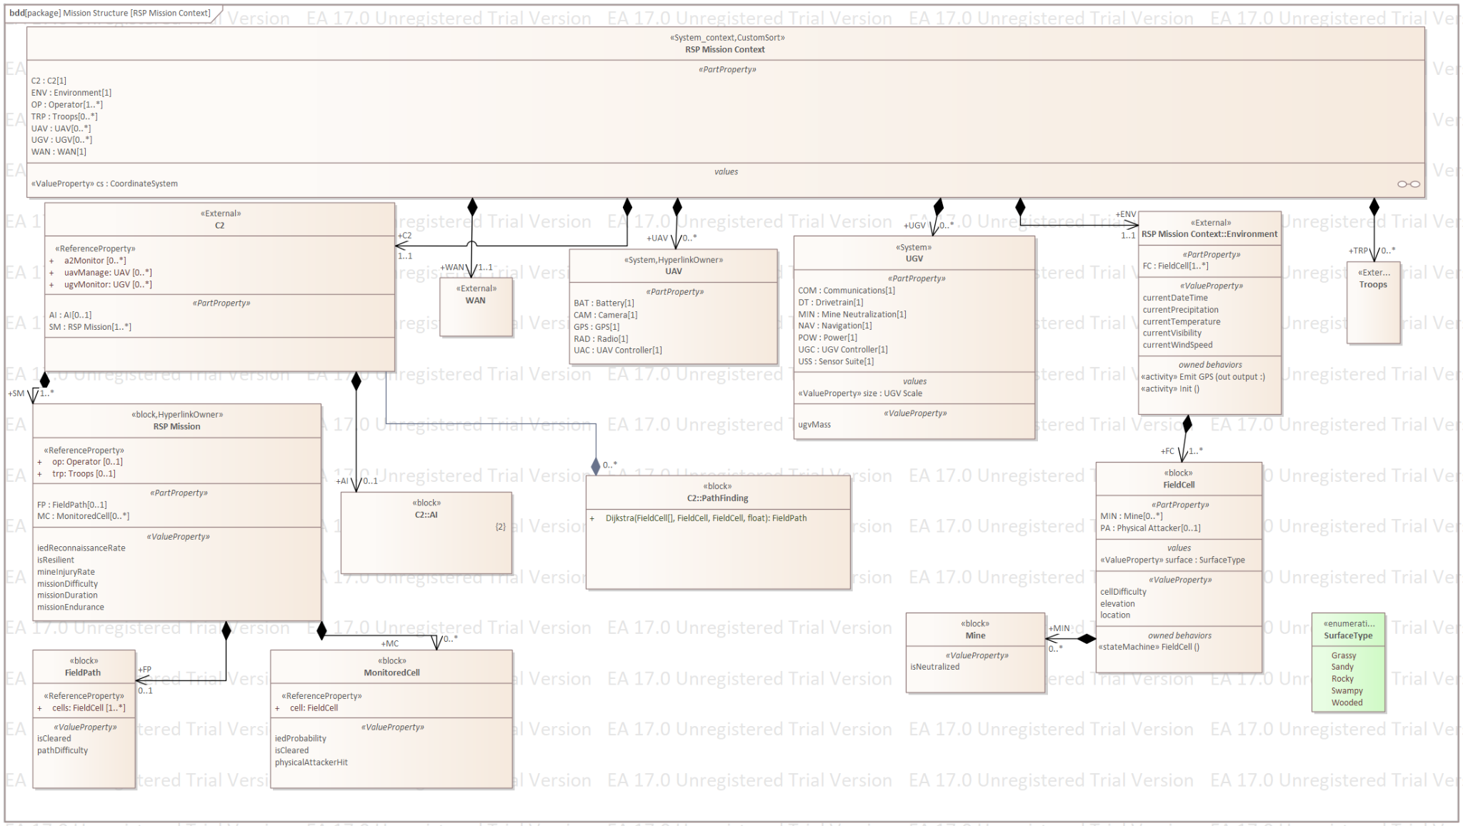
Simulation Infrastructure

Slide 13
Managing Risks in the System
Optimized Mission Planning: Combines UAV and UGV functionalities to ensure safe and efficient traversal.
Confidence-Driven Decisions: Incorporates confidence scores to enhance decision-making during pathfinding.
Terrain-Specific Adaptation: Leverages terrain weights for tailored operations.
Visualization: Provides clear and informative maps with color-coded annotations for path, mines, and cleared areas.

Slide 14
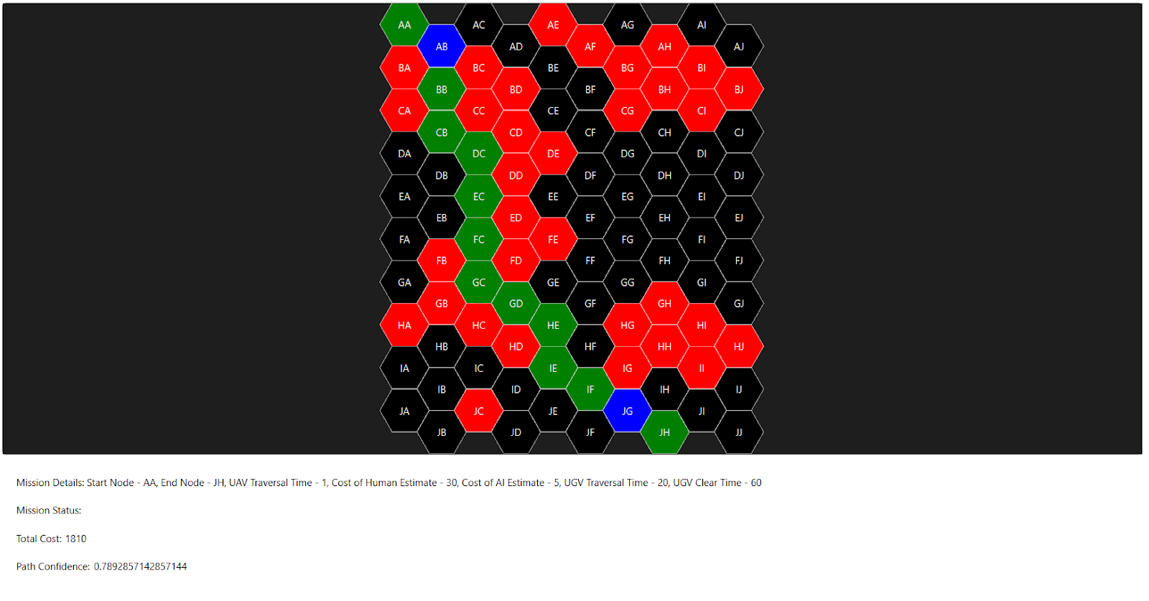
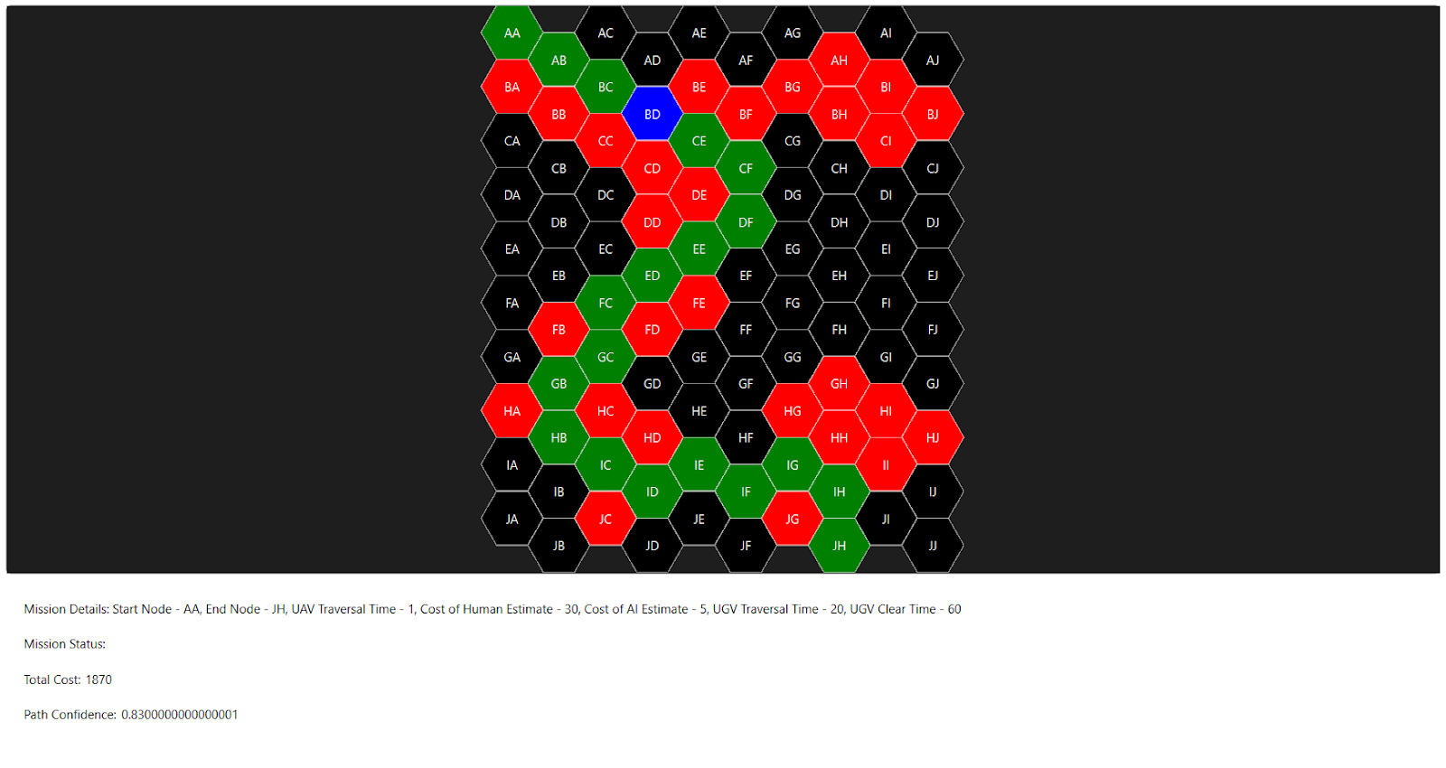
Scenario Testing and Validation:

Slide 15
Preparing for the Next Stage:
Scenario Extension and Testing:
Developing a scenario generation tool to create diverse and unseen operational environments.
Expanding testing capabilities to assess the system's robustness and adaptability under varying conditions and constraints.
Quantitative Performance Metrics:
We will focus on optimizing the system to improve detection accuracy and enhance cost efficiency, ensuring measurable improvements in performance for quantitative scoring.
Innovative Risk Analysis
Designing and incorporating a simulation-based risk analysis module to:
Predict potential mission impacts of mine encounters.
Proactively evaluate risks and develop mitigation strategies.
Strengthen mission reliability and safety while addressing lethality challenges.

Slide 16
Final Thoughts
In this work we tried to bridge AI implementation with mission reliability and the framework lays the groundwork for a great example for trusted AI systems in dynamic operations.
Thank you
Any Questions ?

